Slide 1

basic school management system
Yahia Ehab
21/8/2026

Slide 2
basic school management system
The School System application is a simple graphical user interface designed to manage student records.
It contains text fields for entering a student’s name and grade, along with two main buttons: Add Student and Delete Selected Student.
When a student is added, their information appears in the large display area below, which serves as a list of all current students.
The delete function allows the user to remove any selected student from this list.

Slide 3
Problem
The problem here is managing student information manually. Without a digital system, teachers or administrators would need to rely on paper records or scattered notes, which can lead to:
Errors when adding or removing students.
Difficulty in keeping records organized.
Wasted time searching for or updating student details.
No easy way to view all students at once.

Slide 4
Solution
The School System interface solves this by offering a simple digital tool:
Text boxes to enter a student’s name and grade.
An Add Student button to quickly insert new records.
A Delete Selected Student button to remove outdated or incorrect entries.
A list display area to show all students clearly in one place.

Slide 5
Why this help🤔
➕ Add Student
Checks that name and grade are entered, then adds the record.
🔍 Search Student
Finds matching students using name and optional grade.
✏️ Edit Student
Loads a selected student's details into the input fields.
🗑️ Delete
Removes one selected student or clears the whole list.
💾 Save
Stores current records in a text file.

Slide 6
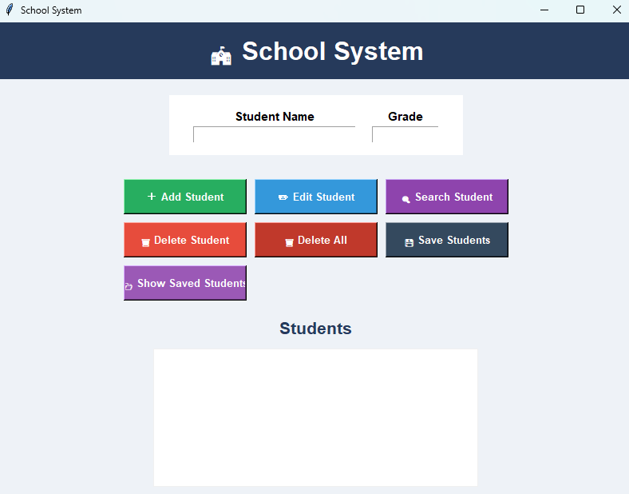
The project:

